Slide 1
Homework 3
COSE331 Computer Graphics

Slide 2
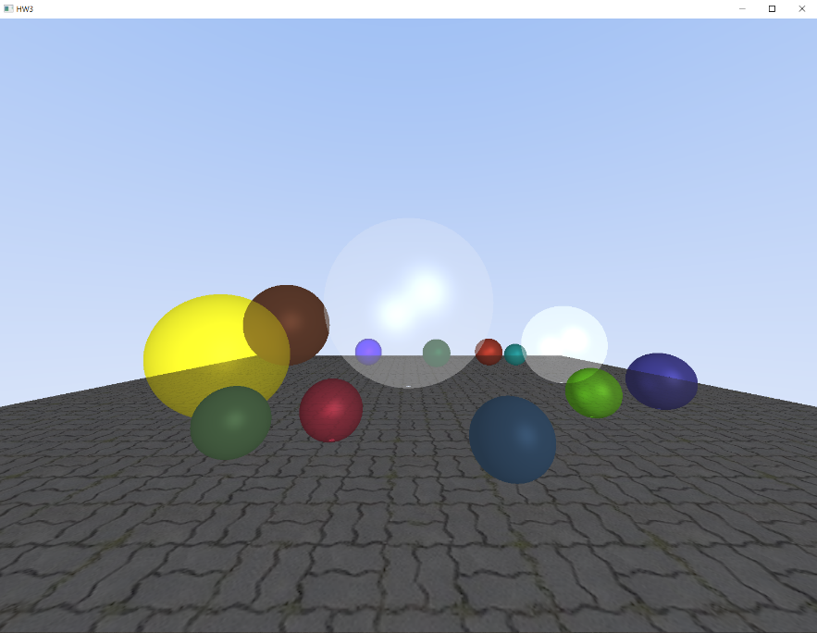
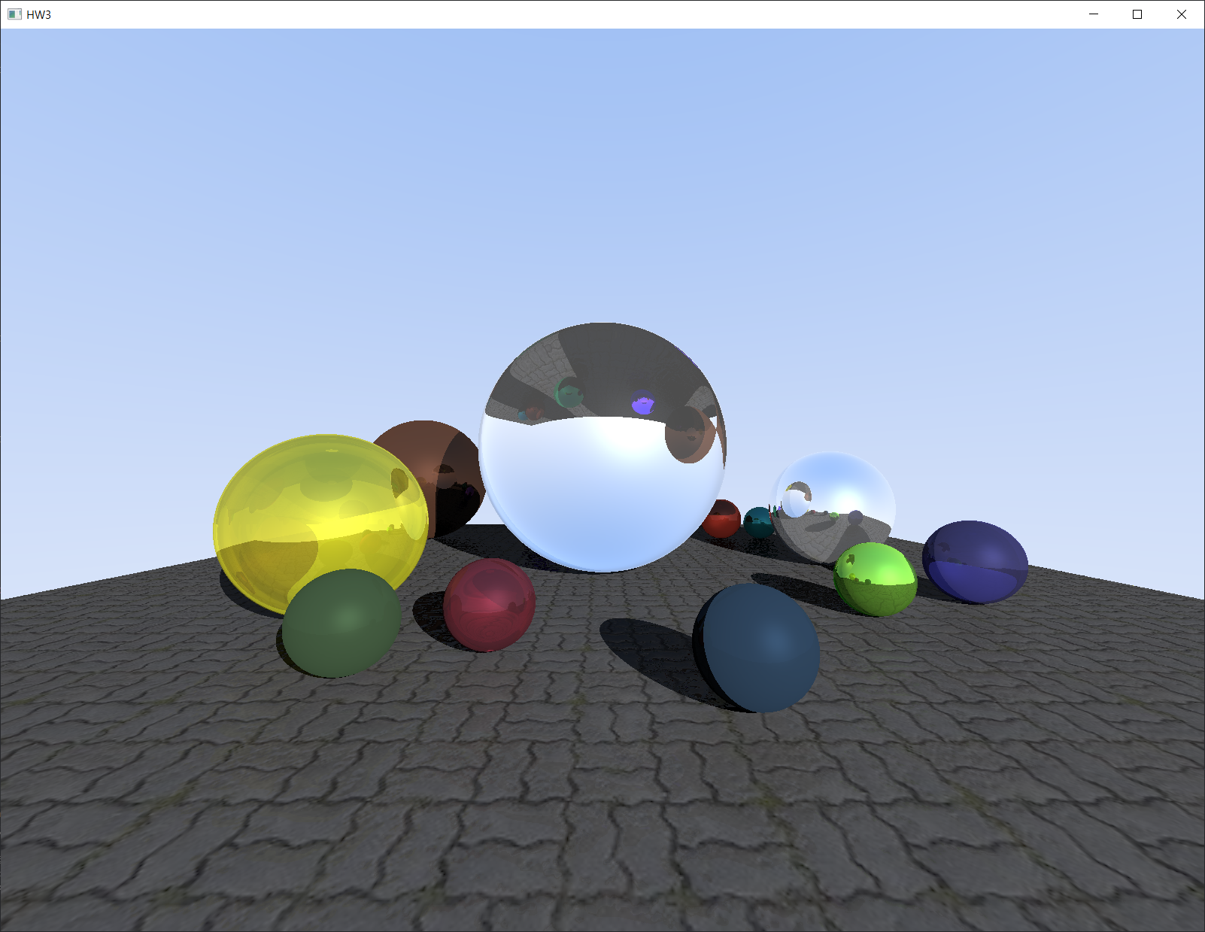
Goal
Render spheres of various materials using ray tracing technique.
Calculate reflection ray, refraction ray, shadow ray
Construct a normal map to shade the floor.

Slide 3

Visual Studio
https://visualstudio.microsoft.com/ko/downloads/
Visual Studio for C++ is not run on macOS. We highly recommend using Windows device for HW3, contact TAs if you need help.

Slide 4
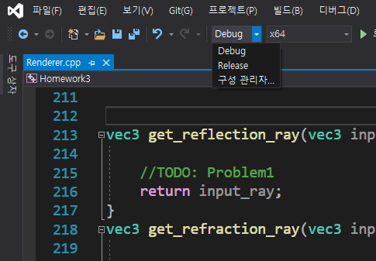
Visual Studio
Open the VS solution file (Homework3.sln)
Change the build configuration to Release

Slide 5
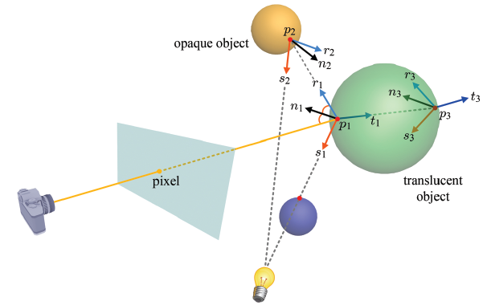
Ray Tracing
vec3 get_color(int depth, vec3 eye, vec3 ray)
Sums three ray colors: reflection ray, refraction ray, shadow ray.
Then the result is multiplied piecewise with the shaded color, making a color bias.
(The code for this part is provided.)

Slide 6
Problems
Fill in some empty functions in Renderer.cpp file.
vec3 get_reflection_ray(vec3 input_ray, HitData hit)
vec3 get_refraction_ray(vec3 input_ray, HitData hit, Material m)
bool is_lighted(vec3 eye)
void construct_normal_map(img_height, img_normal)

Slide 7
Problem 1
vec3 get_reflection_ray(vec3 input_ray, HitData hit)
Calculate the reflection ray.
Primary ray incident data is stored in HitData. (see page 16)
The returned vector must be normalized.

Slide 8
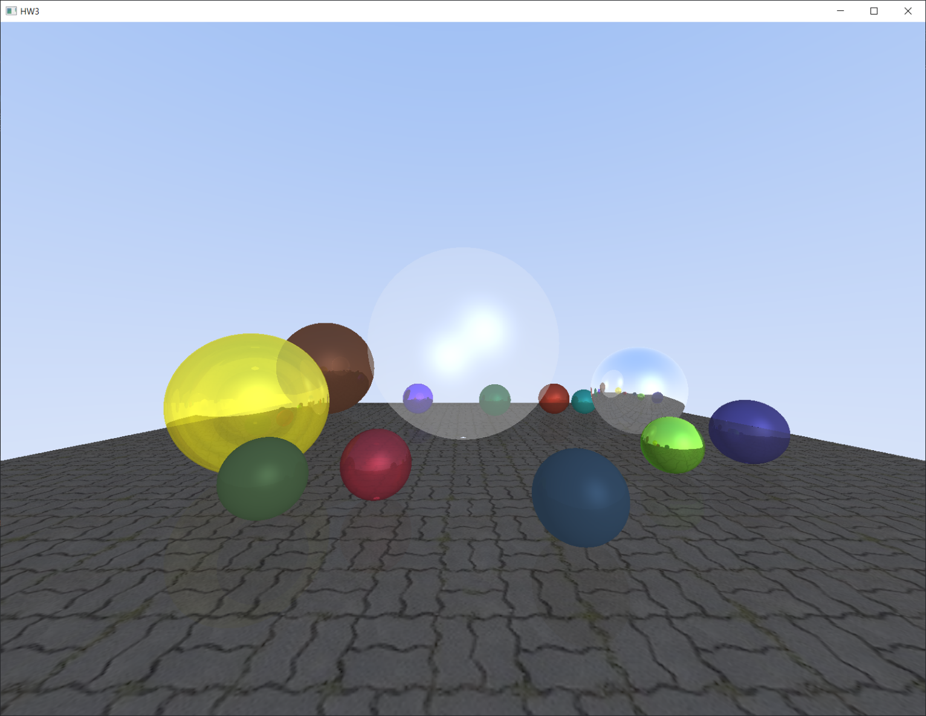
Problem 1

Slide 9
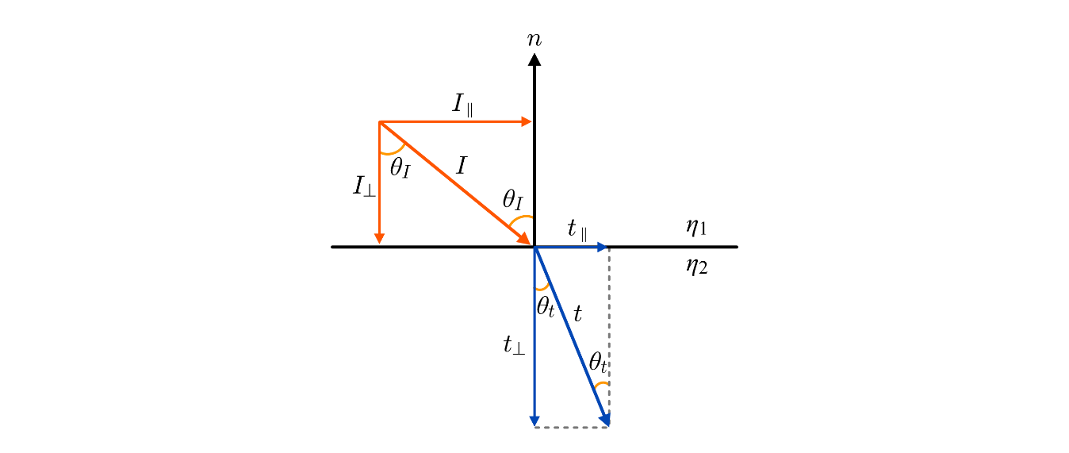
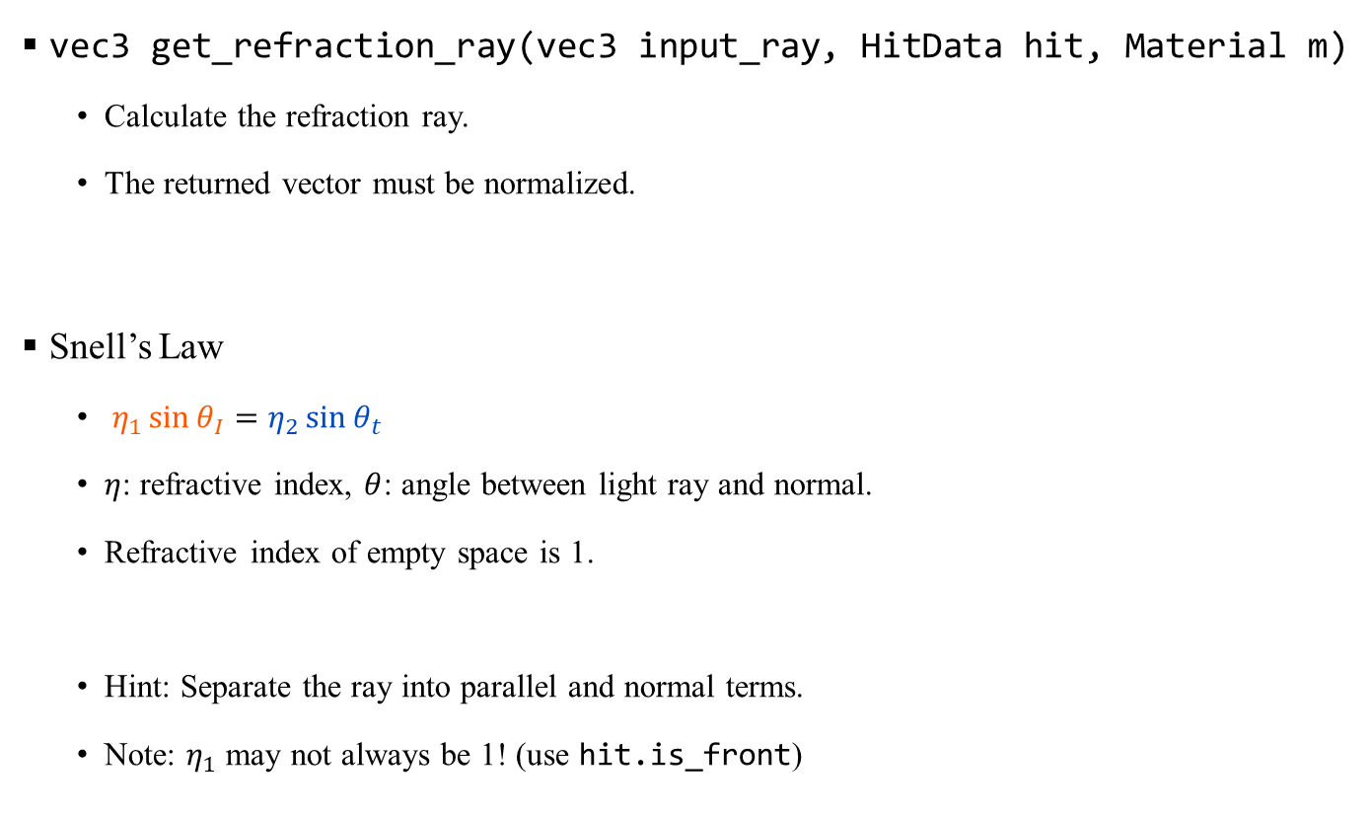
Problem 2
vec3 get_refraction_ray(vec3 input_ray, HitData hit, Material m)
Calculate the refraction ray.
The returned vector must be normalized.
Snell’s Law
$η_{1}\sin{θ_{I}}=η_{2}\sin{θ_{t}}$
$η$: refractive index, $θ$: angle between light ray and normal.
Refractive index of empty space is 1.
Hint: Separate the ray into parallel and normal terms.
Note: $η_{1}$ may not always be 1! (use hit.is_front)

Slide 10
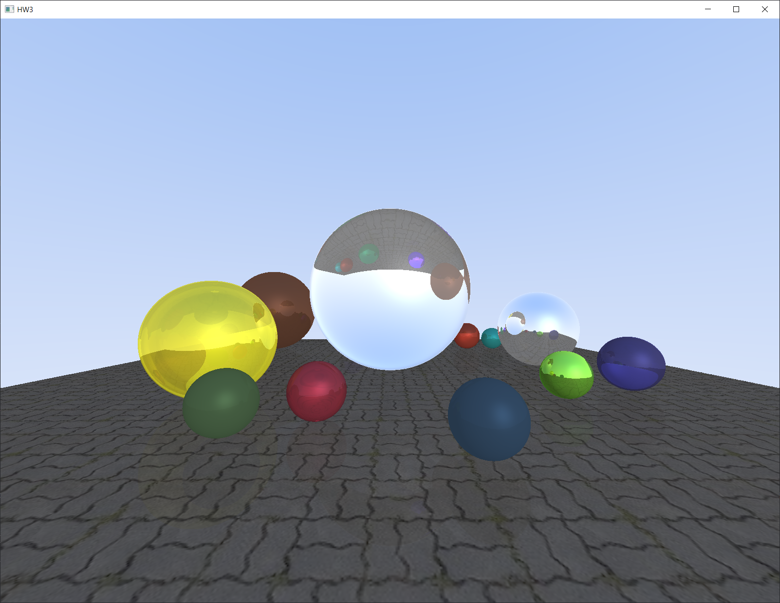
Problem 2

Slide 11
Problem 3
bool is_lighted(vec3 eye)
Determine if the surface is in shadow.
Use the function get_closest_hit to see if the shadow ray hit an object.

Slide 12
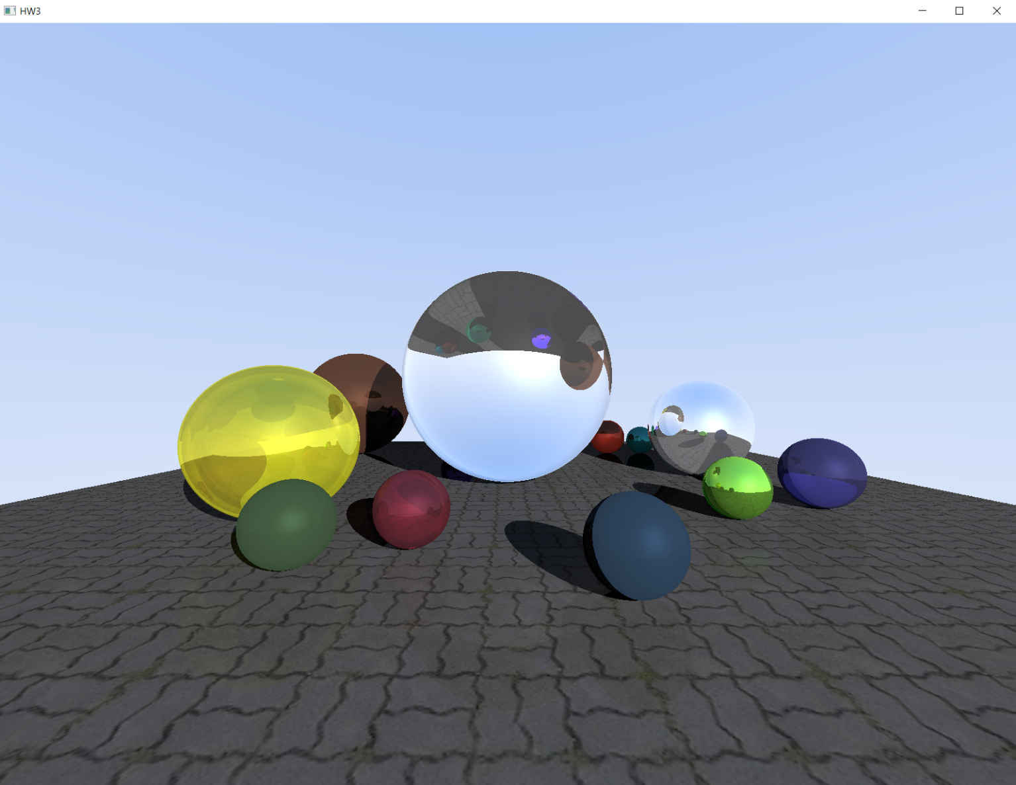
Problem 3

Slide 13
Problem 4
void construct_normal_map(img_height, img_normal)
Construct a normal map from height map.
Height map, a grayscale image, is loaded from ./res/height_map.png to img_height as RGB vector. Note that the RGB values are scaled between 0 and 1.
Save the normal map in img_normal.

Slide 14


Problem 4
You can modify WINDOW_WIDTH and WINDOW_HEIGHT to get a higher resolution image.

Slide 15
Result

Slide 16
struct HitData
bool is_hit
False if the ray hit nothing
vec3 position
Position of the closest hit
vec3 normal
Normal vector of the hit surface
float t
Distance from the ray origin to the hit position
bool is_front
True if the ray hit the front face of the object, false when it hit the back face
int object_index
ID of the hit object; 0~12 for spheres, 100 for floor

Slide 17
struct material
vec3 color
float diffuse, ambient, specular
Variables used in Phong shading
float n
Refractive index of the material (see page 9)
float reflection, refraction
Specular reflectance coefficient and transmission coefficient of the material

Slide 18
Submission
Deadline
June 13 (Mon) 14:00
Submission files
Rename the file Renderer.cpp to {student_id}_{name}.cpp
Please follow the submission format!!
Submission to Blackboard
Contact
TA email: 2022.CG.TA@gmail.com

